Slide 1


Project Title
TEAM MEMBERS:
PRIYA DHARSHINI M [927623BAD085]
PRIYANKA P[927623BAD086]
RAJAVARMAN K[927623BAD087]

Slide 2
PROBLEM STATEMENT / DESCRIPTION:
Develop a Python script to scrape relevant data from Google Maps, focusing on extracting information such as business names, addresses, phone numbers, and ratings.
Utilize web scraping libraries like BeautifulSoup or Scrapy to parse HTML content efficiently.
Implement mechanisms to handle dynamic page loading and pagination to ensure comprehensive data retrieval. Additionally, incorporate error handling to manage potential interruptions and ensure the robustness of the scraping process.
The extracted data should be structured and stored in a suitable format such as CSV or JSON for further analysis or integration into other applications

Slide 3
ABSTRACT :
This project aims to develop a Python-based solution for scraping data from Google Maps efficiently. Leveraging web scraping libraries like BeautifulSoup and Scrapy, the program will extract valuable information such as business names, addresses, contact details, and ratings from Google Maps listings.
The scraping process will be designed to handle dynamic page loading and pagination, ensuring comprehensive data retrieval.
Robust error handling mechanisms will be implemented to manage interruptions and ensure the reliability of the scraping process.
The extracted data will be structured and stored in formats like CSV or JSON for further analysis or integration into other applications.
The solution will prioritize modularity and scalability, allowing for easy customization to accommodate different search criteria or geographic locations.
By automating the data extraction process, this project aims to provide researchers, businesses, and developers with a valuable tool for accessing and analyzing location-specific information available on Google Maps.

Slide 4
PROPOSED SOLUTION : To scrape data from Google Maps using Python, you can utilize libraries such as Selenium, BeautifulSoup, or specialized APIs like Outscraper. Here’s a concise guide: Set Up Your Environment: Install Python and pip. Install necessary libraries: REQUESTS,beautifulsoup4 Choose Your Method: BeautifulSoup: Parses HTML to extract data. It’s simpler . Write Your Code: With BeautifulSoup, send a request to the Google Maps URL and parse the response. Handle Data: Store the scraped data in a structured format like JSON or CSV. Ensure compliance with Google’s Terms of Service to avoid legal issues. Remember, web scraping can be legally sensitive, and it’s crucial to respect website terms and privacy policies. Always scrape responsibly.

Slide 5
REAL LIFE APPLICATION:
Retail company planning to open a new store in a particular area can use Google Maps scraping to analyze the competitive landscape.
They can collect data on existing businesses in the vicinity, including their types, sizes, customer reviews, and proximity to potential customers.
This information can inform strategic decisions such as selecting an optimal location, understanding local market dynamics, and tailoring marketing strategies to attract customers.
Google Maps scraping can be used in urban planning and development projects.
City planners and policymakers can extract data on amenities, transportation infrastructure, and public services from Google Maps to assess the accessibility and livability of different neighborhoods.
This information can guide decisions related to urban design, transportation planning, and community development initiatives.

Slide 6
HARDWARE AND SOFTWARE REQUIREMENTS:
Hardware:
A computer with sufficient RAM (at least 4GB) and processing power to handle web scraping tasks and data processing.
Software:
Python: Install the latest version of Python.
2.Libraries:
BeautifulSoup: For parsing HTML and extracting data.
Integrated Development Environment (IDE):
Such as PyCharm or Visual Studio Code for writing and testing your Python code.

Slide 7
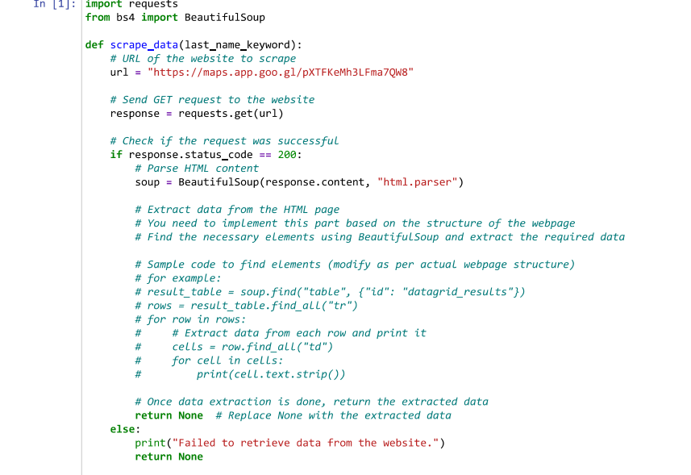
PROJECT CODE:

Slide 8
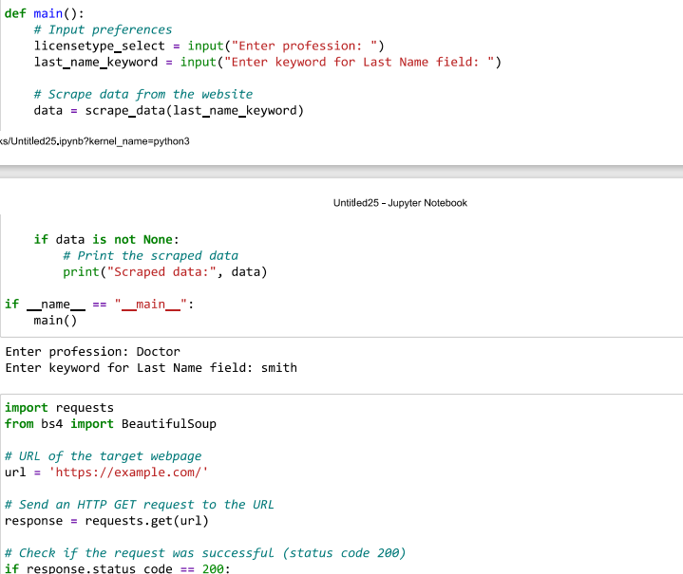
PROJECT CODE:

Slide 9
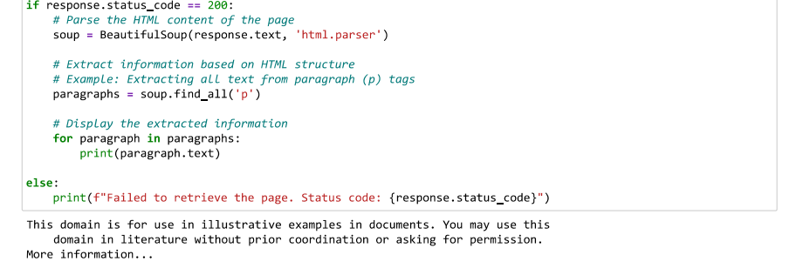
PROJECT CODE:

Slide 10

OUTPUT:

Slide 11

OUTPUT:

